Slide 1

Estimation of Software

Slide 2
Software Project Management
planning
Estimation
Scheduling
Work breakdown structure
Wideband Delphi estimation
LOCs
Functional points
PERT charts / activity networks
Gantt. Charts

Slide 3
Project Estimation
Fundamental questions:
effort required to complete an activity?
calendar time needed to complete an activity?
total cost for an activity?

Slide 4
Project Estimation
key points
Project estimation and scheduling are interleaved management activities.
Project Estimation is done on the basis of :
• Project size
• Project Cost
• Effort required
• Project duration

Slide 5
Software cost components
Hardware and software costs.
Travel and training costs.
Effort costs
The salaries of engineers involved in the project;
Social and insurance costs.
Overheads:
Costs of networking and communications.

Slide 6
costing / pricing
Estimates are made to discover the cost of producing a software system.
There is not a simple relationship between the development cost and the price charged to the customer.

Slide 7
Software productivity
Rate at which developers produce software and associated documentation.
Quality assurance is not involved in software productivity.
Measuring functionality produced per time unit.

Slide 8
Software productivity measures
Size related
Assess as per project Lines of code (in source code)
Approach : LOC estimation
Functionality related
Assess as per the functionalities delivered
Approach : Functional point estimation

Slide 9
Software project estimation
LOC and FP data are used in two ways during software project estimation:
as estimation variables to “size” each element of the software
as baseline metrics collected from past projects and used in conjunction with estimation variables to develop cost and effort projections.
Measured in LOC/pm or LOC/𝑝𝑚⁶

Slide 10
LINES OF CODE ESTIMATION

Slide 11
LOC estimation
Count every line of source code except blanks(improve code readability) or comments (improves code understandability).
Count each declaration, actual code containing logic and computations
Advantages:
✓ Easy to count and calculate
Disadvantages:
✓ Not a good metric , as its highly dependent on the programming language used.

Slide 12
LOC estimation
Break projects into features
Estimate lines of code by analyzing past data. For example, a similar component has been created before , now consider its optimistic, most likely and pessimistic values. Expected size = (S _{optimistic} + 4 * S _{most likely} + S _{pessimistic}) / 6
In upcoming example, the values acquired for the task 3D geometric analysis for past data are :
Optimistic =4600 LOC, most likely = 6900 LOC, pessimistic = 8600 LOC.
So, the Estimated LOC will be calculated using above formula :
Expected LOC = ( 4600+ 4∗6900 +8600 )/ 6
= 6800 LOC

Slide 13
LOC estimation (Example 1)
The mechanical CAD software will accept two- and three-dimensional geometric data from an engineer.
The engineer will interact and control the CAD system through a user interface that will exhibit characteristics of good human/machine interface design.
All geometric data and other supporting information will be maintained in a CAD database.
Design analysis modules will be developed to produce the required output, which will be displayed on a variety of graphics devices.
The software will be designed to control and interact with peripheral devices that include a mouse, digitizer, laser printer, and plotter.

Slide 14
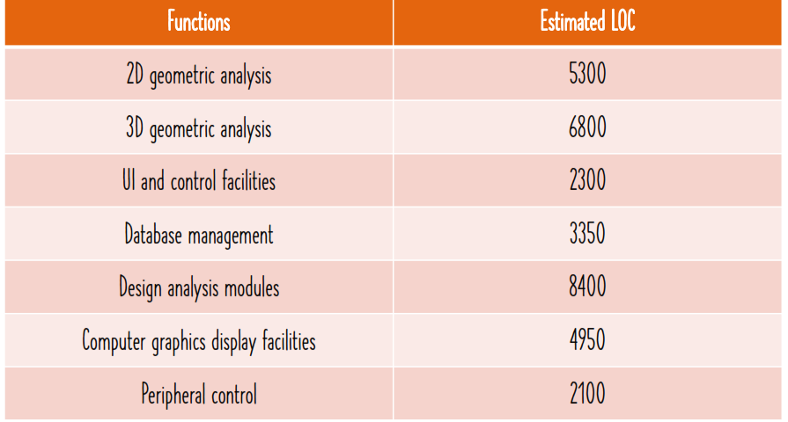
LOC estimation (Example 1) solution

Slide 15
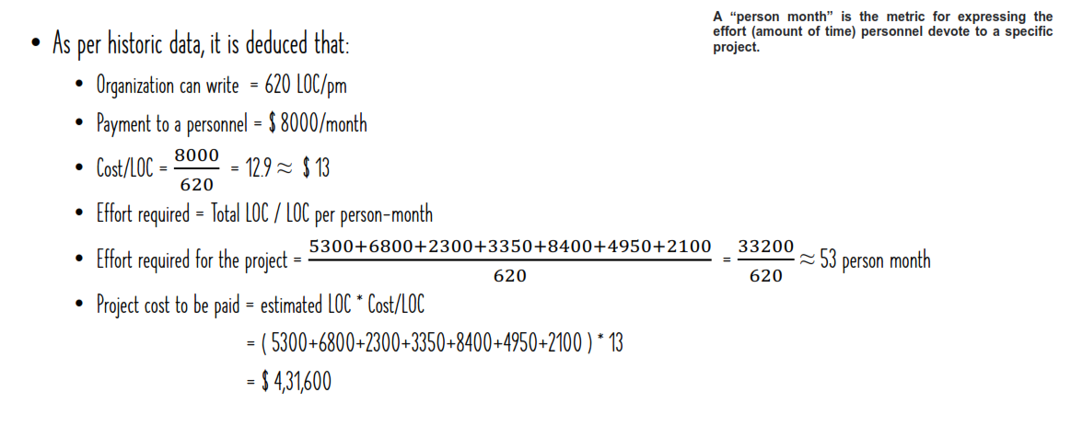
LOC (Example 1) solution

Slide 16
LOC estimation (Example 2)
Login and registration module: 1000 LOC
Search and booking module: 3000 LOC
Payment and checkout module: 2000 LOC
User profile module: 1500 LOC
Feedback and rating module: 500 LOC
Use historical data to estimate the effort required to develop the project:
Average LOC: 600 LOC/pm
Average cost : $8000/ month

Slide 17
LOC estimation (Example 2) solution
Average LOC= 600 LOC/pm
Average cost = $8000/ month
Cost/LOC =8000/600 =13.3
SUM of LOC = 1000+3000+2000+1500+500
= 8000 LOC
Effort = LOC/LOC per pm
= 8000/600
=13.33 pm
Cost = total LOC* Cost per LOC
= 8000 * 13.3
= $106,640

Slide 18
FUNCTIONAL POINT ESTIMATION

Slide 19
FP estimation
Not a language dependent estimator
It measures functionality from a user’s point of view. Like what he/she received or entered to the system.
estimate inputs, outputs, inquiries, files and external
Here,
weight defines the importance and complexity of an operation (LMS would have more I/O operations, phone directory will have more files and searching operations)

Slide 20
FP estimation
Find the number of functions belonging to the following types:
External Inputs: Functions related to data entering the system.
External outputs: Functions related to data exiting the system.
External Inquiries: They leads to data retrieval from system but don’t change the system.
Internal Files: a user identifiable group of logically related data that resides entirely within the application boundary and is maintained through External Inputs. Log files are not included here.
External interface Files: These are logical files for other applications which are used by our system.

Slide 21
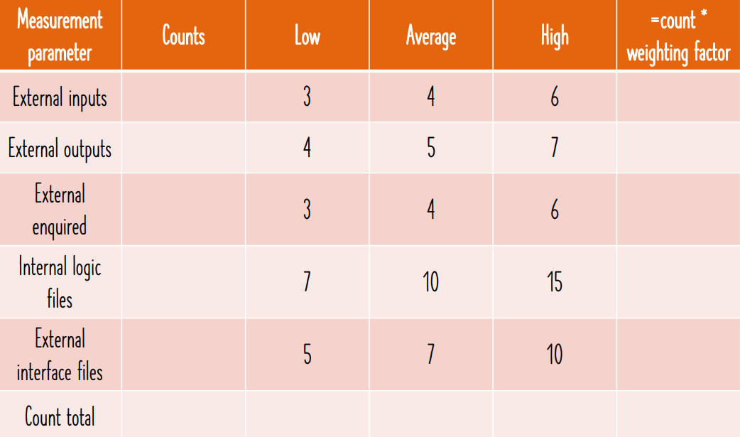
FP estimation
To compute functional points;
FP=UFP * CAF
Where,
UFP = unadjusted functional points,
CAF = complexity adjustment factor
Now calculate UFP, where each FP is ranked as per complexity.
Predefined weights for each category is given in the table. Depends upon the complexity
Calculate CAF
CAF = 0.65 +(0.01 * Σ Fi )
Where, F_{i} is the value adjustment factor depends on the reply to following 14 questions.

Slide 22
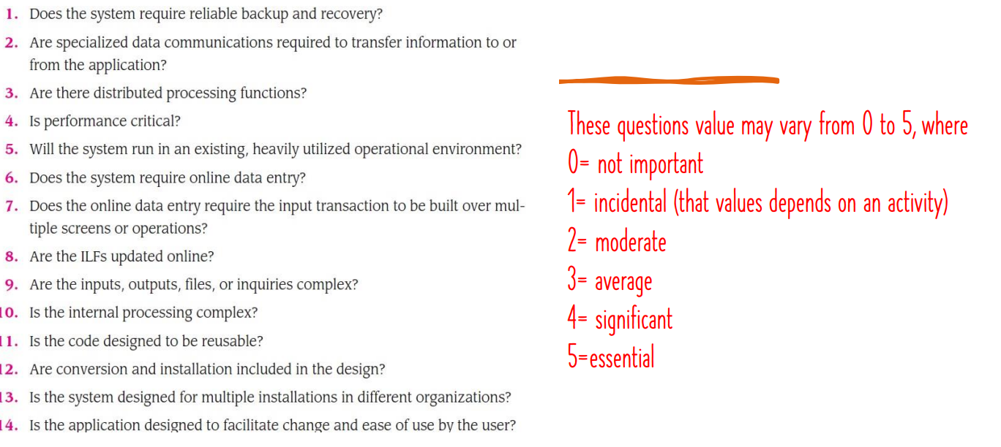
FP estimation

Slide 23
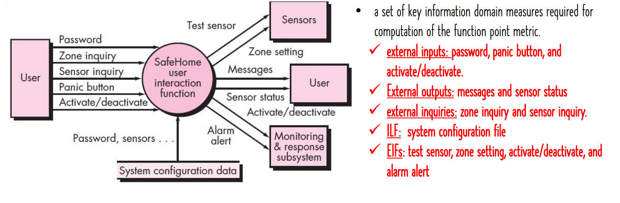
FP estimation (Example 1)

Slide 24
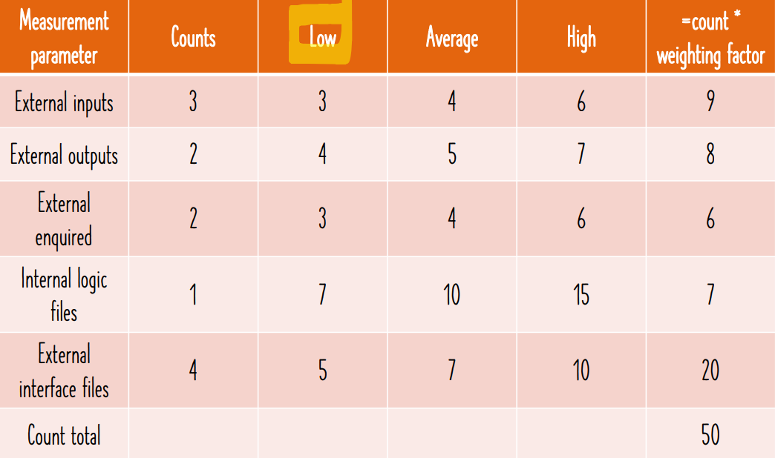
FP estimation (Example 1)

Slide 25
FP estimation (Example 1)
Calculate CAF
CAF = 0.65 +(0.01 * Σ Fi )
Lets say, the product is moderately complex product,
so all 14 questions answered in moderate form i.e. 2
Σ Fi = 14*2 =28
CAF = 0.65 + ( 0.01 * 28) =0.93
FP = UFP * CAF
FP = 50 * 0.93 = 46.5

Slide 26
FP estimation
If lets say team productivity is 60FP/person-week,
Then,
Effort = FP/productivity
= FP/60
If team size =5,
Then,
Project duration = Effort/ team size
= Effort/5 weeks

Slide 27
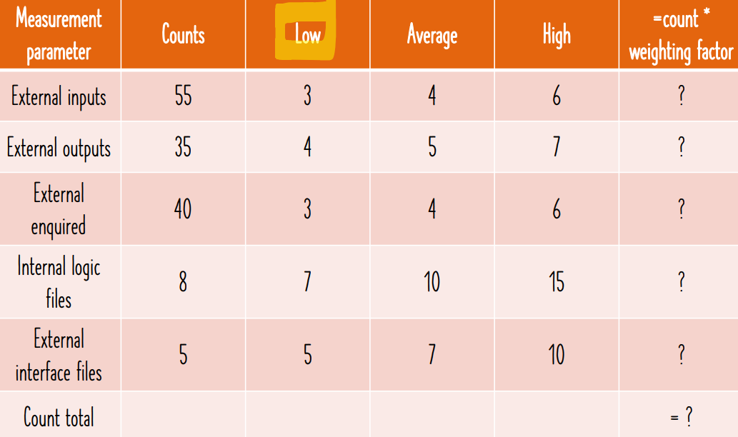
FP estimation (Example 2)
Given,
User input = 55
User outputs = 35
User enquiries = 40
Internal logical files = 8
External interfaces =5
Problem: Calculate FP when the FPs have low complexity and the product is significantly complex product, so all 14 questions answered in moderate form i.e. 4

